Slide 1
hYPERrAIL pROJECT Overview
Jorian Bruslind

Slide 2
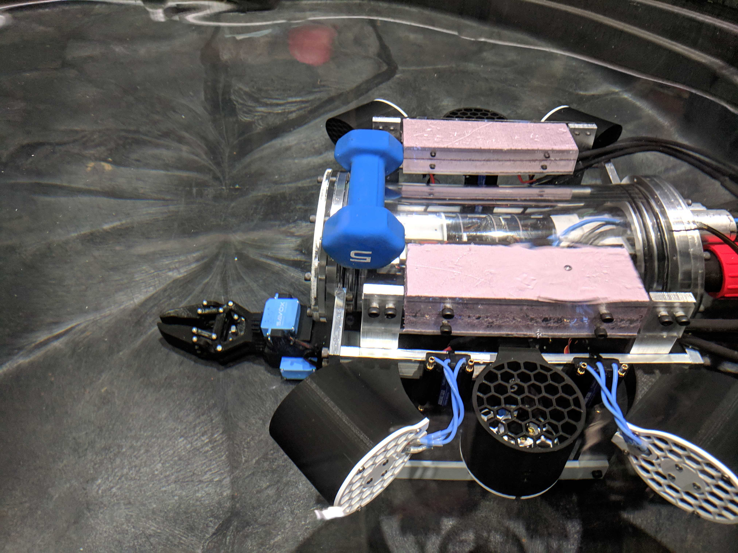
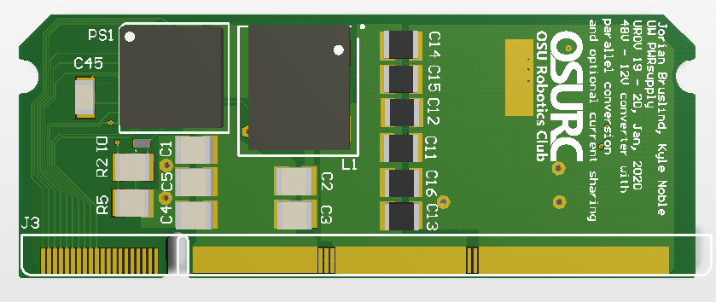
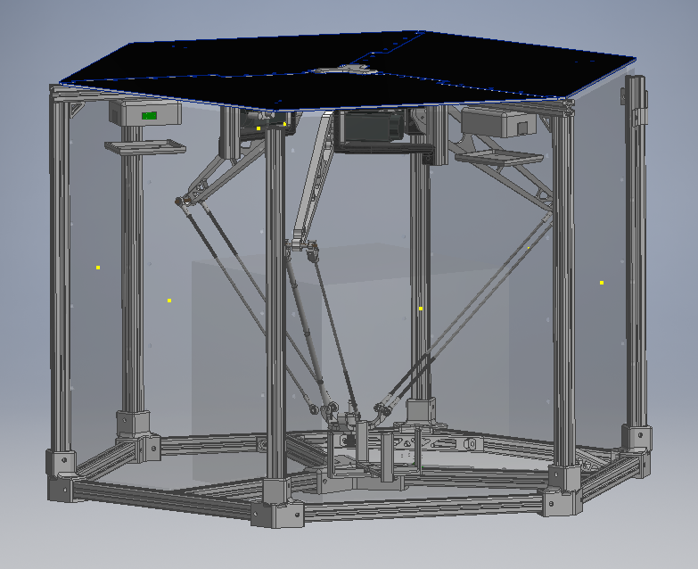
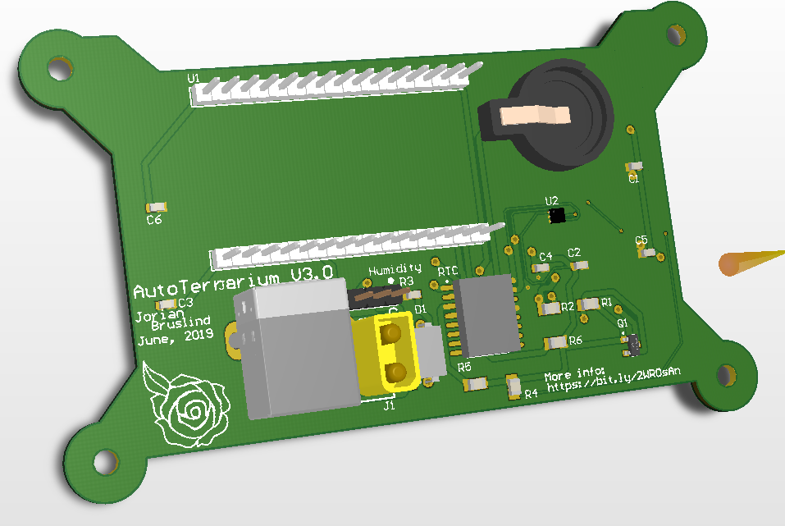
Little bit about me
Senior in ECE (Graduating at the end of Winter)
Part of the OSU Robotics Club (2016 – 2020)
President (2017-2019)
Underwater ROV Team lead (2016-2020)
Enjoy doing electronic projects in my spare time
Home automation
Server management / IOT networks
Capstone Project focused on Robotics / Automated systems
Automated Microbial Analysis

Slide 3
Master’s program
45 Credit program, Project based
Faculty advisors will serve to grade project scope and assist in planning
Current timeline:
Spring 2021: 2 Project Credits (ECE 506)
Fall 2021: 2 Project Credits
Winter 2022: 4 Project Credits
Spring 2022: 4 Project Credits

Slide 4
Current State
Gantry like system to move an end effector in 3D space
Axes are pretty locked up and the carriage needs some fine tuning
Custom firmware built for stepper motor control
Processing GUI used in conjunction with Adafruit M0 Feather
Some LoRa capabilities

Slide 5
Junior Design Groups
4 dedicated groups to working on the HyperRail System
Each group is responsible for motion control using the current system (4x stepper motors + microcontroller)
Each group has been tasked with a unique requirement to improve on the system
Joystick control from computer
Power feedback with low power algorithm
Path planning from image
Wifi control through web interface

Slide 6
My work so far
Created new 3D model using Inventor
Rebuilt frame and linear motion carriages using current components (with some new 3D printed components)
Researched implementations of gantry system in similar use-cases (also some parallel cable robots)
Created discord server for Junior Design groups and am currently helping them figure out implementations / debug
Working with STEMbassadors for support in manufacturing / design

